Slide 1
Graduate Course – Fall 2019
Software Development Technologies
  Prof. Wenyong Wang
  A.Prof. Yu Xiang
Email : wangwy@uestc.edu.cn
jcxiang@uestc.edu.cn
Notes:
Software engineering is an engineering discipline which is
concerned with all aspects of software production.

Slide 2
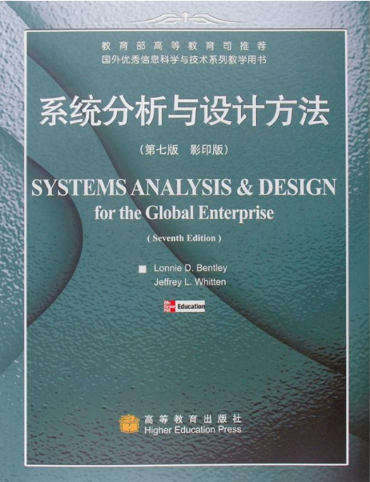
About the Course
Systems Analysis & Design
for the Global Enterprise
（7th Edition）
Jeffrey L. Whitten
Lonnie D. Bentley
Notes:
另一本参考教材：john W. satzinger Robert B.Jackson Stephen D. Burd著
结构化方法和面向对象方法并行介绍，不是作为计划外的附加内容加入的，而是要求每个人都熟悉面向对象的主要概念。在介绍系统分析时，分别介绍传统的需求描述方法，以及面向对象的需求描述方法；设计方法也介绍了采用结构化方法进行设计，以及采用面向对象进行系统设计。相比而言，比较复杂，难度大，适用于计算机专业学生。在学习时，可以把另外这本书作为参考学习资料。本书主要以结构化方法为主，面向对象方法作为前沿性的知识进行介绍。比较符合我们这门课的教学大纲。
这是一本关于如何实践信息系统开发方法的书；所有的企业都会开发信息系统；可以肯定你将在某些系统的系统分析和设计中扮演某个角色－－系统客户、用户或者系统开发者；
系统分析和设计技术涉及业务问题的解决计算机应用程序的开发；你可以将学到的方法应用于很广泛的问题领域，而不仅仅是计算机领域。
从信息系统最初出现：50年代TPS系统到现在，已经经过了几十年的历史，在这个过程中，人们也总结了系统分析与设计的基本方法，一般原则，可以用来指导我们的实践，这也就是我们要学习和掌握的主要内容。但是，掌握了好的方法并不意味着一定能够开发出好的系统。在掌握原则的基础上，还要根据开发环境和系统要求的不同，更多地进行实践，这是最关键的。

Slide 3
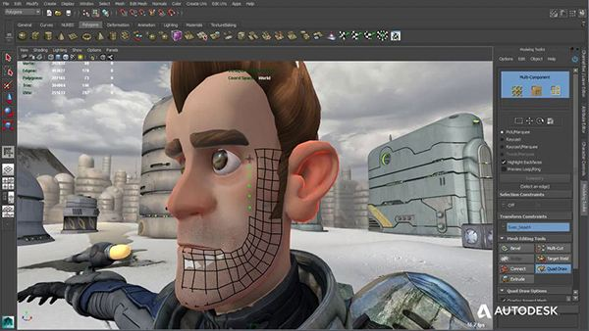
What is inside?

Slide 4






What is inside?

Slide 5
Framework
1:The value of system analysis and design
2:The components of software systems
3:Developing software systems
4:Project management
Part I: Developing Systems
5:Systems analysis
6:Requirements gathering
8:Data modeling and analysis
9:Process modeling
11:Feasibility analysis and system proposal
Part II: Systems Analysis
Methods
12:Systems design
13:Application Architecture and modeling
14:Database design
15:User interface design
Part III: Systems Design
Methods
Part IV: Beyond Systems
Analysis and Design
17:Systems construction
and implementation
7: Use cases
10:Object-oriented analysis and modeling
using the UML
16:Object-oriented analysis and modeling
using the UML
Part V: Object-Oriented
Modeling
Notes:
在我们正式学习之前，首先介绍一下这本书的框架，以便于大家对我们所要学习的内容有个概括性的认识，从而了解哪些是重点内容，哪些是非重点内容。系统建设过程中的参与者：包括系统所有者、用户、设计者、分析员、咨询师等。
信息系统构建模块：本书从过程模块、数据模块、以及接口模块的角度进行描述信息系统。过程建模：逻辑模型、物理模型、数据流程图等。数据建模：E-R模型 对象建模：UML模型
系统开发过程：分析、设计、编码、实施、运行与维护等过程。
项目管理：因为系统开发过程多数是以项目的方式进行启动的，所以离不开项目管理。
这四个组成部分构成了信息系统的体系框架，也就是系统分析与设计的整体环境。系统分析：介绍了系统分析的主要方法，如模型驱动法、累积分析法、需求发现法、业务流程重组方法等。还介绍了系统分析的几个阶段：初步调查、问题分析、需求分析、决策分析等阶段。
需求发现：介绍了需求发现的过程，也就是从何处入手去寻找需求，例如，首先从问题入手，列出需求，形成文档，再对需求进行管理。需求发现的方法，有很多，如调查表、面谈、文档、表格、观察等。

Slide 6
Chapter One
The Value of
Systems Analysis and Design
Notes:
数据建模与分析：什么是数据模型，如何构建数据模型。
过程建模：什么是过程模型，如何构建过程模型。这两个部分是系统分析的关键，也是本书的重点内容。
可行性分析：从哪几部分分析可行性，如操作可行性、技术可行性、进度可行性、经济可行性等；还有成本收益分析，备选的系统方案，形成可研报告。最后形成系统建议书，也叫需求说明书。
系统设计：系统设计方法，包括模型驱动法、快速应用开发方法，以及系统设计的步骤。应用体系结构和建模：物理的数据流程图、数据、接口、过程的体系架构等。数据库设计：包括数据库设计的范式输入和输出等。
系统建设与实施：构建阶段主要包括系统的网络建设、数据库建设、软件包安装、程序编写；实施阶段主要包括执行系统测试、准备转换计划、安装系统、数据库，用户培训等，新旧系统的切换等。系统运行与支持：主要是指系统的运行与维护阶段，如何进行改进，如何进行恢复，如何进行废除，以及一些技术支持活动。第五部分主要介绍系统地面向对象分析与设计，包括面向对象的概念，建模的过程。
通过这张图，我们对整个书的结构有个总体性的认识，可以看出，第一部分给出一个完整的地图，第二部分和第三部分是地图中最重点最核心的部分，是我们学习的重点，第四部分是辅助部分介绍。前四部分是一个完整综合的整体。第五部分是对新技术的描述，也是需要深入学习的地方。

Slide 7
Topics
1.1 A Framework for Systems Analysis and Design
1.2 The Players – System Stakeholders
1.3 Business Drivers for Today’s Software Systems
1.4 Technology Drivers for Today’s Software Systems
1.5 A Simple System Development Process
Notes:
第一部分集中于系统分析和设计的整体描述，即介绍系统分析与设计的基本概念、原理、发展趋势，它们构成系统分析与设计方法的基础
包括4章内容
第1章介绍系统分析和设计的参与者，主要强调现代系统分析员作为系统工作推进器的作用。了解到系统分析员、最终用户、管理人员和其他信息系统专家之间的关系，最后学习如何成为一名系统分析员
第2章介绍构建的产品－信息系统。将讲解如何以常用构件的方式看待信息系统：数据构件、过程构件、接口构件－每个构件都从不同的参与者和关联人员的角度来观察。引入一个矩阵框架结构组织这些构件，以便看到它们在后续章节的应用
第3章介绍一个通用的信息系统开发过程，这个过程称为系统开发生命周期，并以系统开发方法学介绍系统开发过程
第4章介绍项目管理技术。所有系统项目都依赖这些原理。并介绍项目管理的两个建模技术：甘特图和PERT图。这些工具有助于读者安排活动、评估进展和调整计划

Slide 8
1.1 A Framework for Systems Analysis and Design
Business Drivers
The “Product”---
A Software System
Project
And
Process
Management
Players
Technology Drivers
Notes:
这本书主要讲述系统分析和设计的方法。使用了一个简单但是全面的可视化框架结构来介绍。
前四章（第一部分）主要构建了这个可视化框架。第一章介绍环境；第二章介绍信息系统构件；第三章介绍信息系统开发过程；第四章介绍项目管理。系统环境：如上图所示。
本书介绍如何“分析”信息系统的业务需求，如何“设计”满足业务需求的信息系统，以及如何使用信息技术。
－信息系统 information system (IS) 是人、数据、过程、信息表示和信息技术的组合，它们之间相互作用，支持并改进企业每天的运作，支持管理人员和用户解决问题和进行决策。
－信息技术Information technology (IT)描述了计算机技术(硬件和软件)通信技术(数据、图像和语音网络)的组合。 －关联人员 stakeholder 是对某个已有信息系统或新信 息系统有利益关系的人。关联人员可以是技术工人，也可 以是非技术工人。

Slide 9
1.2 The Players – System Stakeholders: Information Workers
Business Drivers
Project
And
Process
Management
Players
System Owners
System Users
System Designers
System Builders
System Analysts
The Project Manager
Software Systems
Technology Drivers
Notes:
关联人员分成5类。知识工人（Knowledge workers）是知识工人的一个子集，他们的工作基于专业化的知识。
信息工人（Information workers） 描述在工作中涉及到创造、收集、分发和使用信息的人。
系统所有者System owners –是信息系统的发起人和主要倡导者，他们通常负责投资项目以进行开发、运行和维护信息系统
系统用户System users – 是那些在通常意义上使用信息系统或者受到信息系统影响的人－－如收集、验证 、录入、响应、存储、交换数据和信息。常用的同义词是客户。内部用户Internal users 办事员和服务人员; 技术人员和专业人员; 主管、中层经理和高层经理;远程和移动用户 外部用户External users
系统设计员System designer – 将系统用户的业务需求和约束条件转换成技术方案。他们设计满足系统用户需求的计算机文件、数据库、输入、输出、屏幕界面、网络和程序。
系统构造人员System builders – 根据系统设计人员的设计说明构造信息系统构件。在许多情况下，一个构件的系统设计人员和系统构造人员是同一个人。

Slide 10
1.2.1 System Owners
Sponsor and executive advocate of an software system
Responsible for funding and maintaining the system
Interested in: Cost, Value/Benefits
Owners in Medium to Large systems —— Middle or executive managers
Owners in Smaller systems —— Middle managers or supervisors
Notes:
Teaching Notes
Using the information system described earlier (enrollment system or other), for the college, invite the class to identify individuals who might play the system owner role.

Slide 11
1.2.2 System Users
Use or affected by a software system
Capture, validate, enter, respond to, store, and exchange data and information
Same as “Customers”
Internal system users—— Clerks and service staff; Technicians and professionals; Supervisors, middle managers and senior managers.
External system users——Customers, suppliers, collaborators, employees; Remote and mobile users.
Notes:
Teaching Notes
Update students on the trend of “telecommuting.” Telecommuting falls into our “Remote” users category.
Some students may confuse “remote users” and “external users.” The difference is that remote users work for the organization in question, while external users work for some other organization (or are direct consumers).
The growth of the Web is driving the increase in both remote and external users.
Using the information system described earlier (enrollment system or other), for the college, invite the class to identify individuals who might play the system user role.

Slide 12
1.2.3 System designers
Translate system users’ business requirements and constraints into technical solutions
Design computer databases, inputs, outputs, screens, networks and software that meet the system users’ requirements
Including:
Database administrators, network architects, web architects, graphic artists, security experts and technology specialists.
Notes:
Teaching Notes
Using the information system described earlier (enrollment system or other), for the college, invite the class to identify individuals who might play the system designer or system builder role.
Programmers are typically viewed as system builders, but in fact, they are also system designers since good programmers design the software they build.
You might want to remind students that a single individual can play multiple roles in a project. For example:
A person could be both a system owner and system user.
Many systems analysts are also system designers and builders.
In reality, most technical specialists serve in most roles. For instance, database specialists typically design and construct databases.

Slide 13
1.2.4 System Builders
Construct information systems and components based on the design specifications generated by the system designers
In small organizations, system designers and system builders are often the same people
Including:
Application programmers, system programmers, database programmers, network administrators, security administrators, webmasters and software integrators.
Notes:
Teaching Notes
Using the information system described earlier (enrollment system or other), for the college, invite the class to identify individuals who might play the system designer or system builder role.
Programmers are typically viewed as system builders, but in fact, they are also system designers since good programmers design the software they build.
You might want to remind students that a single individual can play multiple roles in a project. For example:
A person could be both a system owner and system user.
Many systems analysts are also system designers and builders.
In reality, most technical specialists serve in most roles. For instance, database specialists typically design and construct databases.

Slide 14
1.2.5 System analyst
  Study problems and needs of an organization
  Determine how people, data, processes and information technologies can best improve business
  Understand both business and computer technology
  Bridge communication gap between technical staff and nontechnical staff
  Business analysts are system analyst who focus on business problems analysis and nontechnical problems analysis
Notes:
业务人员定义需要解决的业务问题, 计算机程序员和技术人员应用IT解决这些问题。
IT提供能够提供收集和存储海量数据，高速准确地提供给管理者相关的信息，但是，这种潜力可能业务管理者不能充分意识到。因为他们不能够充分理解现有技术的能力以及存在的局限性。
同样，计算机程序员和专家不懂得他们所要开发和要支持的系统。
比如，业务人员需要开发一个用户订货服务子系统，主要处理用户订货、报价和询问，但是开发人员可能不懂得订货流程，可能会忽略一些关键的功能，比如察看是否按期交货等。
比如，技术人员可能懂得数据挖掘技术，但是不知道这种技术能够具体应用到业务数据的预测和分析中。
这种沟通之间存在障碍，所以需要有既懂业务又懂技术的人进行沟通。
Why analyst? 计算机专家只注意纯技术问题;企业业务人员不能完全理解现代信息技术的能力与不足;系统分析员连接这个断层，增加计算专家和业务人员的沟通

Slide 15
1.2.5 System analyst
  1.2.5.1 The Role of the System Analyst
  The system analyst is basically a problem solver.
  The term Problem:
  Problems, either real or anticipated, that require corrective action;
  Opportunities to improve a situation despite the absence of complaints;
  Directives to change a situation regardless of whether anyone has complained about the current situation.
Notes:
系统分析员基本上是一个problem-solver.

Slide 16
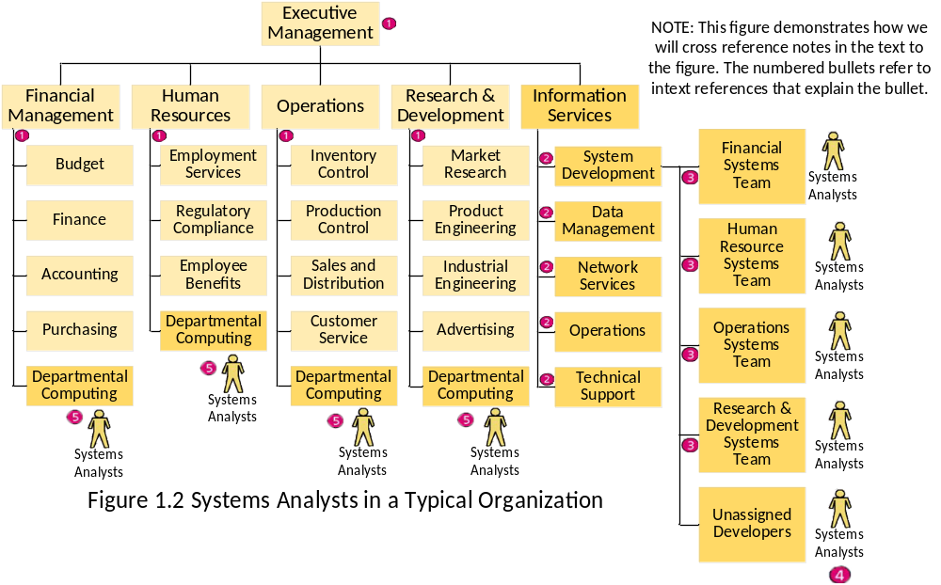
1.2.5 System analyst
  1.2.5.2 Where Do System Analysts Work?
Notes:
Teaching Notes
Note that every organization structures itself uniquely
Systems Analysts also work for:
Outsourcing businesses
Consulting businesses
Commercial software developers
Conversion Notes
This is an expanded view compared to the comparable figure in the 5th edition. This provides a picture of the entire organization and the various place where systems analysts work
在传统业务中,信息服务通常在整个组织中是集中的.信息服务对整个组织来说是集中式的。信息服务部门直接向CEO报告，最高级别的信息长官叫CIO。这样，信息服务和传统的业务职能，比如财务，人力资源，销售和市场，生产部门等处于同样重要的级别。
信息服务部门按照下面的职能进行组织：系统开发；数据管理；通信；终端用户计算；计算机操作。
Center for excellence:一组专家,为整个项目建立和实施方法\工具\技术.组成人员包括:有经验的系统分析员,系统设计人员和系统建设人员.他们提供整个项目的咨询和指导服务.

Slide 17
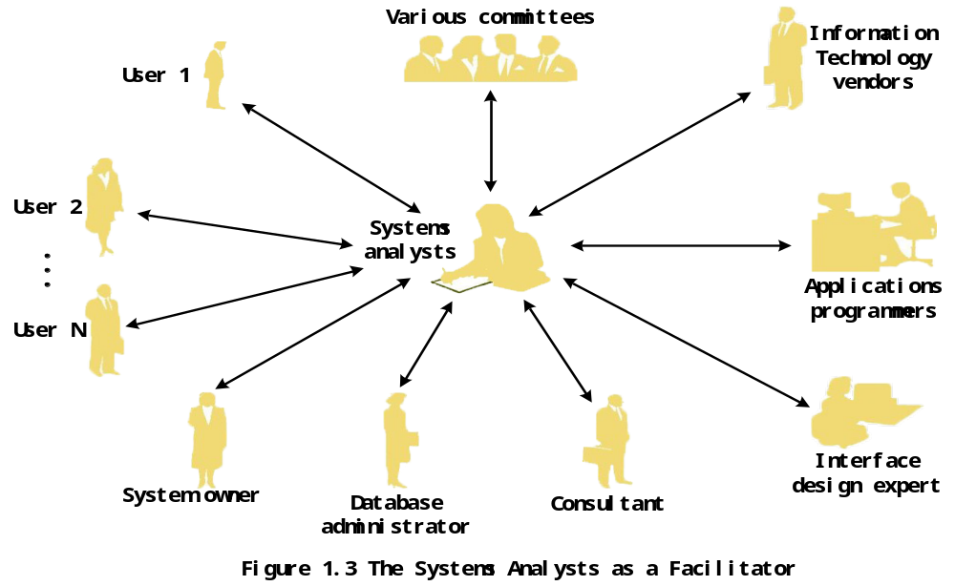
1.2.5 System analyst
  1.2.5.3 Career Prospects for System Analysts
Notes:
现代信息服务组织中的系统分析员：信息服务对整个组织来说是分散式的。
现代组织中，尤其是大中型企业的信息服务部门进行了重组，基本上处于分散化，关注授权和动态团队。
按照项目进行划分的组织结构：项目通常是一次性的，具有特定的目标和教扶贫，有特定的开始和结束日期，并划分为明确的阶段。
比如有的行业，组织在各地设有分公司，都有自己的信息系统部门。在开发全局的信息系统时，需要由高级经理、项目发起人、用户经理、项目经理组成信息化领导小组，或者是指导委员会，然后从各个团队抽调人员，临时组成项目组，进行开发。开发结束后，再回到各自岗位中去。系统分析员也被抽调到项目组中。
所以，信息服务部门看成是一种联盟，没有永久的职能部门。为完成某个项目暂时结合到一起。
在这种类型的组织中，信息服务部门需要更接近用户和管理者，以提高服务和价值。

Slide 18
1.2.5 System analyst
1.2.5.4 Skills Needed by the System Analyst
Working knowledge of information technologies
Computer programming experience and expertise
General knowledge of business processes and terminology
General problem-solving skills
Good interpersonal communication skills
Flexibility and adaptability
Character and ethics

Slide 19
1.2.6 External Service Providers
  Sell expertise and experience to other businesses to help them purchase, develop, or integrate their information systems;
  Can be a contracted system analyst, system designer, or system builder
  Affiliated With a consulting or services organization
  Examples:
  Technology engineers, sales engineers, systems consultants, contract programmers, and systems integrators.

Slide 20
1.2.7 The Project Manager
  An experienced professional who accepts responsibility for planning, monitoring, and controlling projects with respect to schedule, budget, deliverables, customer satisfaction, technical standards, and system quality;
  Project management is a specialized role that requires distinctive skills and experience;
  Most project managers are experienced systems analysts, but some are selected from the system owners.
Notes:
现代信息服务组织中的系统分析员：信息服务对整个组织来说是分散式的。
现代组织中，尤其是大中型企业的信息服务部门进行了重组，基本上处于分散化，关注授权和动态团队。
按照项目进行划分的组织结构：项目通常是一次性的，具有特定的目标和教扶贫，有特定的开始和结束日期，并划分为明确的阶段。
比如有的行业，组织在各地设有分公司，都有自己的信息系统部门。在开发全局的信息系统时，需要由高级经理、项目发起人、用户经理、项目经理组成信息化领导小组，或者是指导委员会，然后从各个团队抽调人员，临时组成项目组，进行开发。开发结束后，再回到各自岗位中去。系统分析员也被抽调到项目组中。
所以，信息服务部门看成是一种联盟，没有永久的职能部门。为完成某个项目暂时结合到一起。
在这种类型的组织中，信息服务部门需要更接近用户和管理者，以提高服务和价值。

Slide 21
1.3 Business Drivers
The Business Drivers
The “Players”
System Analysts
Project Managers
System Owners
System Users
System Designers
System Builders
Software Systems
The “Process”
Globalization of the economy
Electronic commerce and business
Security and privacy
Collaboration and partnership
Knowledge asset management
Continuous improvement
Total quality management
Business process redesign
The Technology Drivers

Slide 22
1.3.1 Globalization of the Economy
Globalization of the economy
  New and expanded international markets
  New international competitors
Impacts on software systems
  They must support multiple languages, currency exchange rates, international trade regulations, and different business cultures and practices
  Integration of international data are required
  Communicate with people from different language backgrounds
Notes:
Conversion Notes
New to 6th edition
Teaching Notes
If you use an in-class computer and project, go to www.amazon.co.uk or a similar international e-commerce site to demonstrate the globalization of commerce.

Slide 23
1.3.2 Electronic Commerce and Business
Electronic commerce(e-commerce)
Electronic business(e-business)
Different types:
Marketing of corporate image, products, and services
Business-to-customer(B2C)
Business-to-business(B2B)
Impacts on software systems:
Most new systems are being designed for an Internet architecture
Applications are increasingly being designed to run within an Internet browser, client operating system is relatively unimportant
Notes:
Conversion Notes
New to 6th edition
Teaching Notes
Since the Internet is global, the Internet drives globalization and vice-versa.

Slide 24
1.3.3 Security and privacy
Security
  How will the business continue in the event of a breach or disaster—any event that causes a disruption of business activity?
  How can the business protect its digital assets from outside threats?
Privacy（GDPR, CCPA 2018）
  Consumers are increasingly demanding privacy in the digital economy.
  Governments are regulating privacy issues.
Impacts on software systems
  More stringent security and privacy controls are expected.
Notes:
Conversion Notes
New to 6th edition
Teaching Notes
With the growth of e-commerce and e-business, security and privacy have become much more important.
With globalization information systems must comply with security and privacy laws of multiple countries. What if the security laws of one country conflicts with the privacy laws of another?
安全主要围绕业务的连续性方面来考虑

Slide 25
1.3.4 Collaboration and Partnership
Management is emphasizing the need to break down the walls that separate organization departments and functions.
Management speaks of “cross-functional” teams that collaborate to address common business goals from interdisciplinary perspectives.
The trend toward collaboration extends beyond the organization to include other organizations — even competitors.
Notes:
Conversion Notes
New to 6th edition
Teaching Notes
Since the Internet is global, it has both driven and enabled collaboration and partnership.
竞合：

Slide 26
1.3.5 Knowledge Asset Management
Knowledge asset management
  Data, information, and knowledge are considered critical business resources.
  How can the company manage and share knowledge for competitive advantage?
  Integration of data and information, creating and preserving knowledge.
Data
Information
Knowledge
Notes:
Conversion Notes
Knowledge Asset Management is new to the 6th edition
The distinction between data and information was has been moved from chapter 2 in the 5th edition.

Slide 27
1.3.6 Continuous Improvement and Total Quality Management
Continuous Process improvement(CPI)
  Reducing cost, improving efficiencies, increasing value and profit.
  Total Quality Management(TQM)
  “Obsessive” attitude
Notes:
Conversion Notes
Knowledge Asset Management is new to the 6th edition
The distinction between data and information was has been moved from chapter 2 in the 5th edition.

Slide 28
1.3.7 Business Process Redesign
  Business process redesign(BPR) involves making substantive changes to business processes: maximizing efficiency and minimizing costs.
  How to implement: build it or buy it.
Notes:
Conversion Notes
Knowledge Asset Management is new to the 6th edition
The distinction between data and information was has been moved from chapter 2 in the 5th edition.

Slide 29
1.4 Technology Drivers
The Business Drivers
The
“Process”
The “Players”
System Analysts
Project Managers
System Owners
System Users
System Designers
System Builders
Software Systems
Networks and the Internet
Mobile and wireless technologies
Object technologies
Collaborative technologies
Enterprise applications
The Technology Drivers

Slide 30
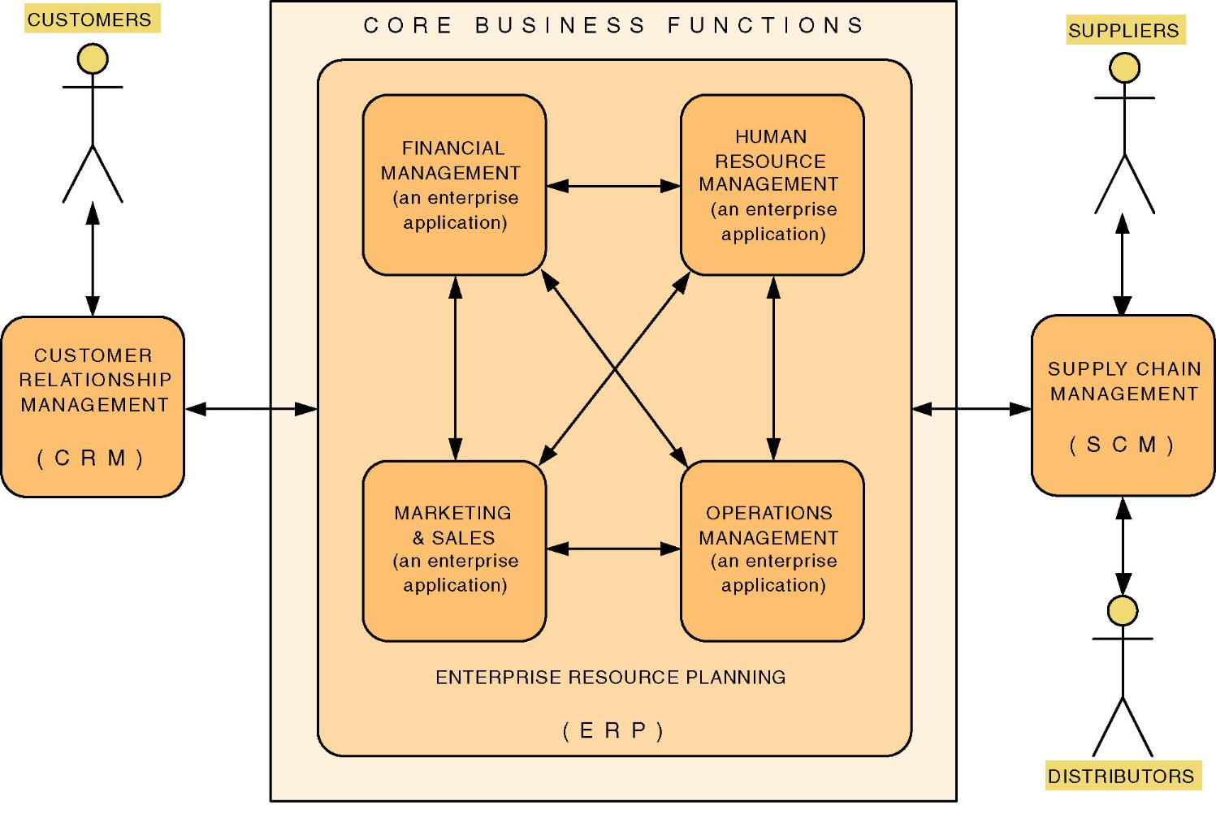
1.4.5 Enterprise Applications
Notes:
几乎所有组织都需要一套核心企业应用来保证业务运行。

Slide 31
1.5 The Development Process
Business Drivers
The
“Players”
The “Process”
Software
System
System Initiation
Project
and
Process
Manage-
ment
System Analysis
System Design
System
Implementation
Technology Drivers

Slide 32
1.5 The Development Process
General problem-solving steps:
  Identify the problem.
  Analyze and understand the problem.
  Identify solution requirements and expectations.
  Identify alternative solutions and choose the best course of action.
  Design the chosen solution.
  Implement the chosen solution.
  Evaluate the results.
Notes:
Teaching Notes
This is not an actual system development life cycle or methodology but simply general problem-solving steps.

Slide 33
1.5 The Development Process
System initiation.
Generate problem statements and project plans; the scope, goals, schedule and budget of the proposed problem.
System analysis.
Business requirements, expectations and priorities.
System design.
Technical blueprints and specifications for the solution to achieve the requirements
Notes:
Teaching Notes
This is essentially the traditional System Development Life Cycle (SDLC) without the system support phase. We elected not to use that term because it invokes negative connotation for many instructors. Some associate it with a pure waterfall development approach (which we consider unfair). We differentiate between development and operation (sometimes called production).
System support is presented in the 6th edition as a separate project – a maintenance or enhancement project that should follow the exact same problem-solving approach, though on a more limited scale.

Slide 34
1.5 The Development Process
System implementation.
Software and hardware development and testing.
System support and continuous improvement.
Training, maintenance, and improvements.
Notes:
Teaching Notes
This is essentially the traditional System Development Life Cycle (SDLC) without the system support phase. We elected not to use that term because it invokes negative connotation for many instructors. Some associate it with a pure waterfall development approach (which we consider unfair). We differentiate between development and operation (sometimes called production).
System support is presented in the 6th edition as a separate project – a maintenance or enhancement project that should follow the exact same problem-solving approach, though on a more limited scale.

